Slide 1
USED CAR PRICE
JUNGU KANG

Slide 2
Objective
To find the best model for predicting a used car price
Language: R
Method: Multiple Linear Regression
Machine Learning

Slide 3
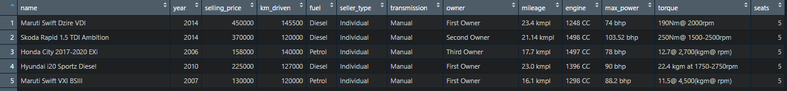
Dataset
From Kaggle
https://www.kaggle.com/nehalbirla/vehicle-dataset-from-cardekho
Target: Selling Price
Features: Year, km, Fuel Type, Seller Type, Transmission,
nth owner, Mileage, Engine, Max Power, Torque, Seats

Slide 4
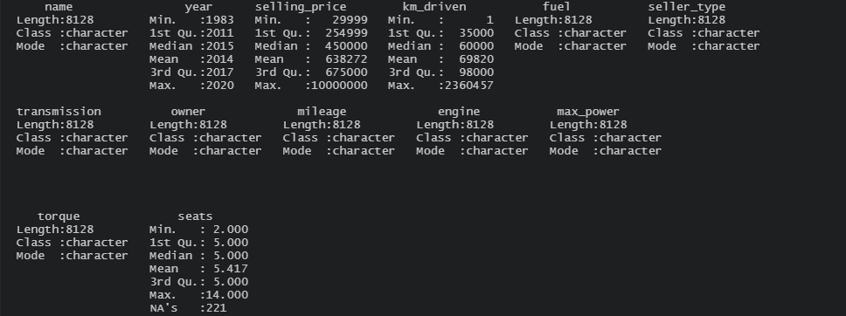
Preprocessing
Some rows are having values of out of range or NA
DROPNA, PARSE NUMBER, FILTER,

Slide 5
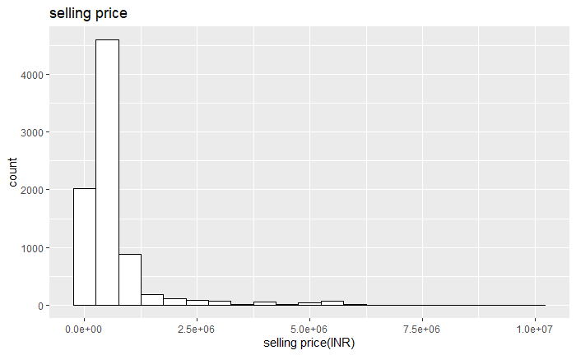
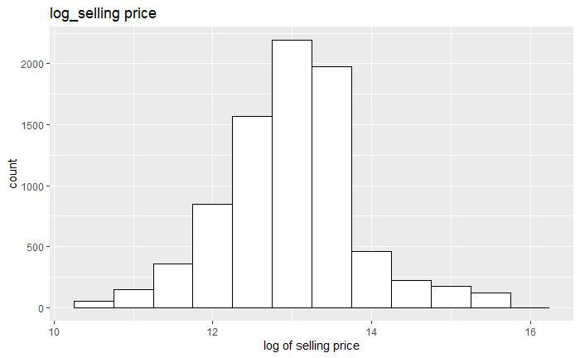
VISUALIZATION
Histogram of selling price
Original vs logarithm

Slide 6
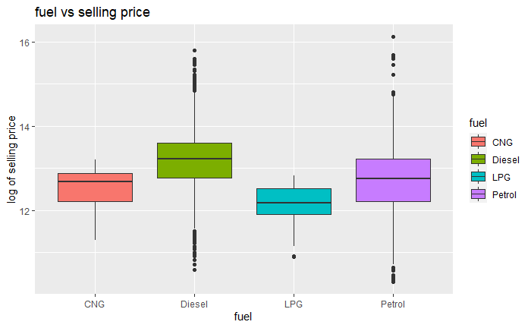
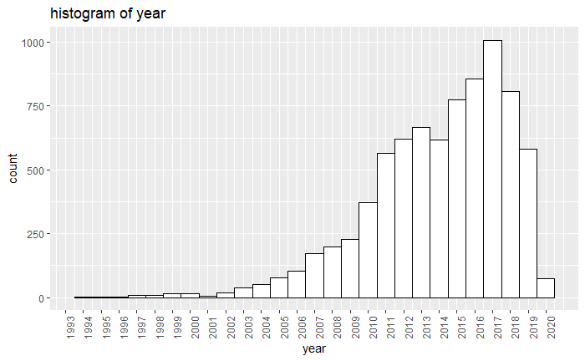
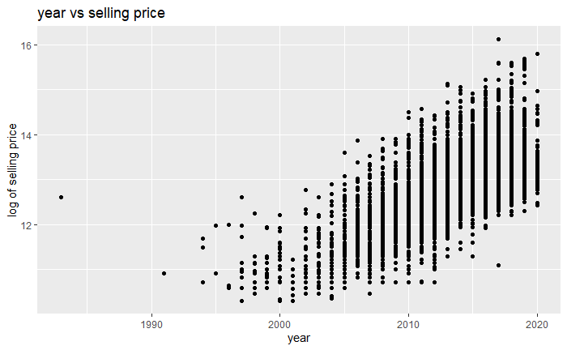
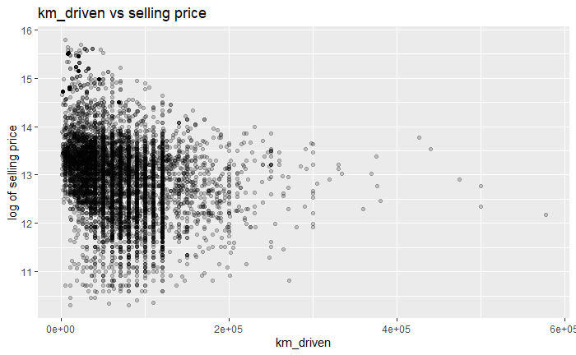
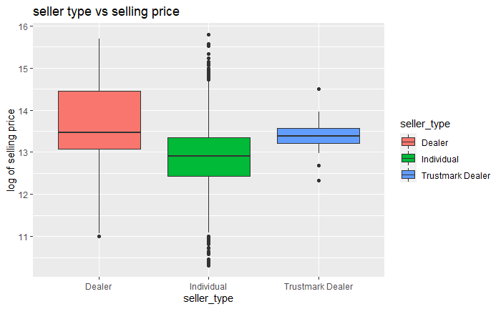
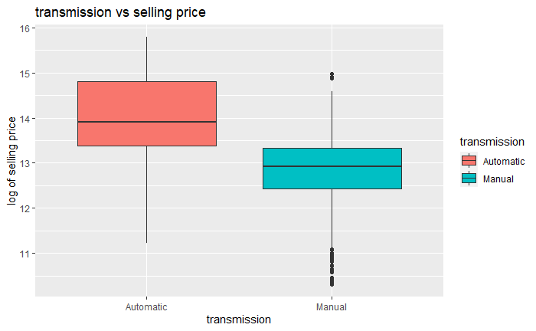
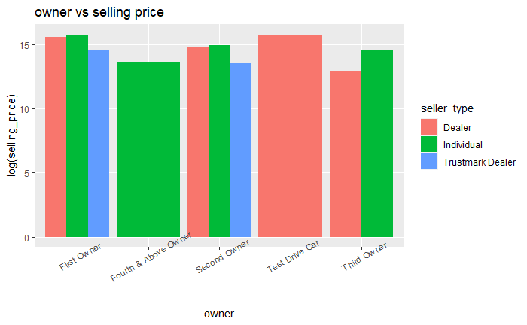
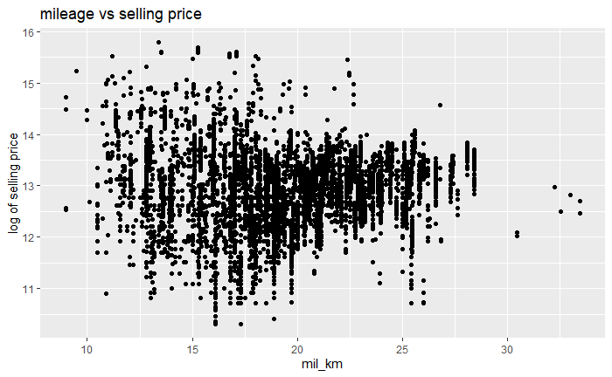
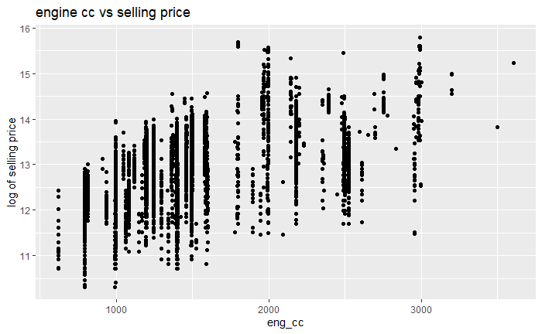
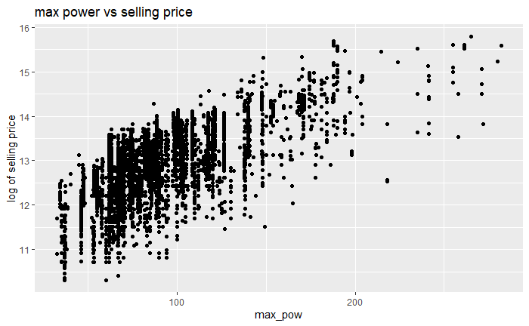
VISUALIZATION
Log of selling price vs other features

Slide 7
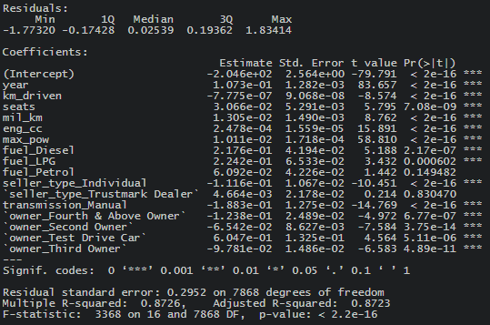
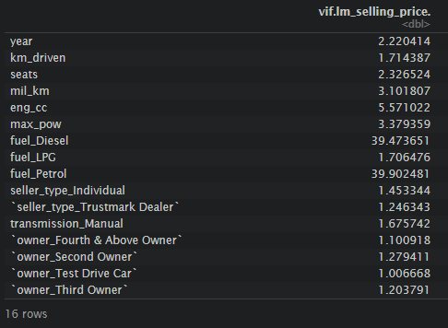
Multiple Linear Regression
Dummify categorical variables
Model 1: all variables
VIF

Slide 8
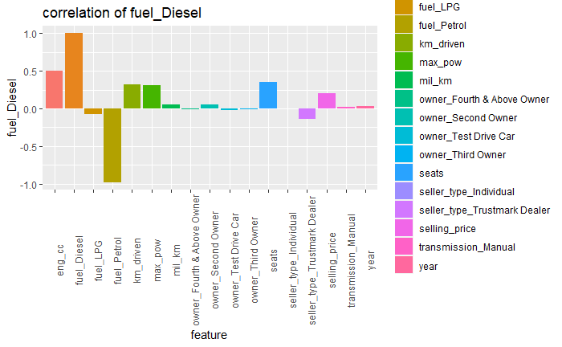
Multiple Linear Regression
Correlation of fuel_Diesel

Slide 9
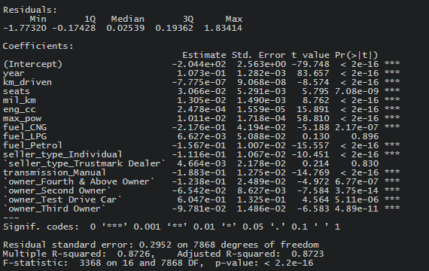
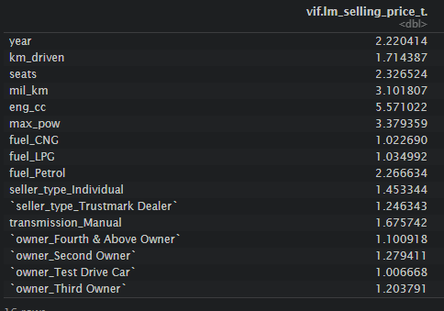
Multiple linear regression
Change fuel column for dummify, DIESEL to CNG, as a result of high VIF score for the first model
Model 1a: all variables

Slide 10
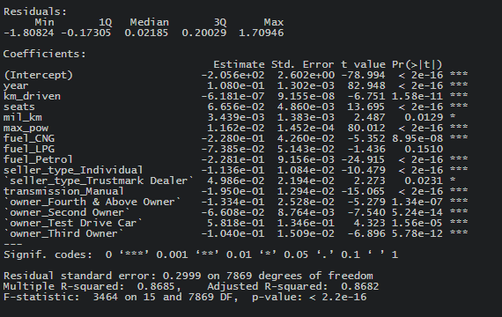
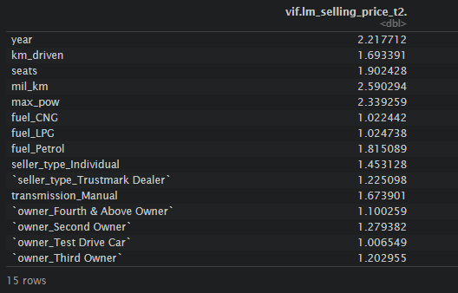
Multiple Linear Regression
Model 2: no engine cc
Take out the features having VIF higher than 5

Slide 11
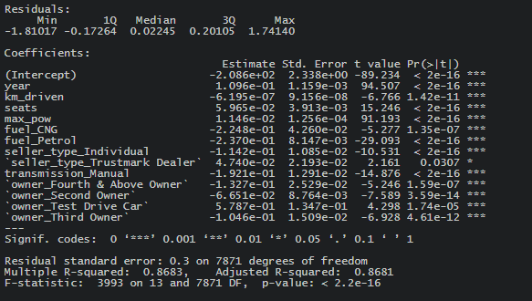
Multiple Linear Regression
Model 3: take out features having p-value >0.05

Slide 12
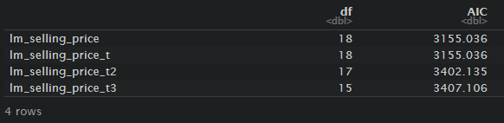
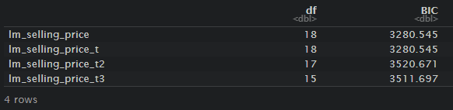
AIC, BIC
Model 1a: all variables(fuel column reselected)
Model 2: no engine cc
Model 3: take out features having p-value >0.05

Slide 13
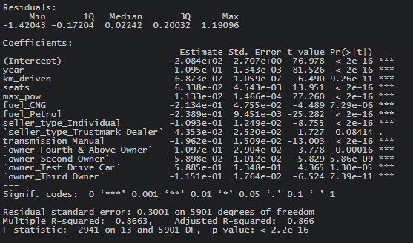
Machine Learning
Train-test split: 75%

Slide 14
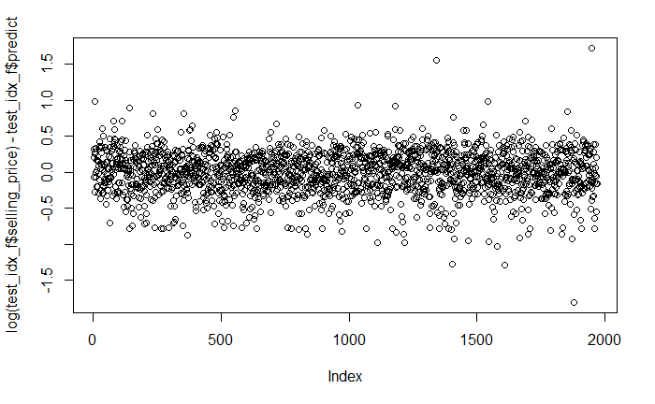
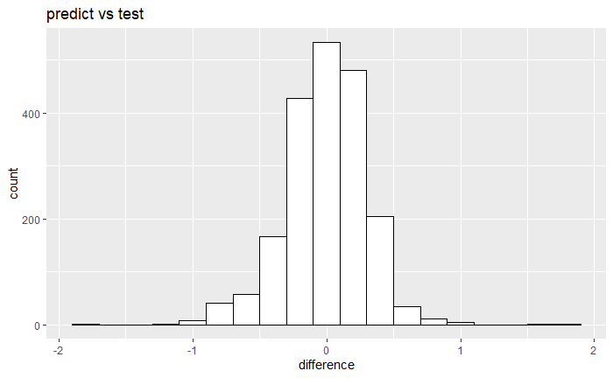
Machine Learning
Predicted R square score: 0.865

Slide 15
Summary & Future study
Original selling price was skewed, so logarithm was applied.
After checking the linear regression assumptions and AIC, BIC scores, the best regression model was chosen as lm_selling_price_t3.
The prediction with the model gives 0.865 of the predicted r square score to the test dataset.
------------------------------------------------------------------------------------------------------
Use different regression models such as RandomForestRegressor and compare the result.

Slide 16
Questions?
Thank you for listening!

